Slide 1


GENERAL SIR JOHN KOTELAWALA DEFENCE UNIVERSITY
FACULTY OF COMPUTING
ESSENTIALS OF ARTIFICIAL INTELLIGENCE
GROUP 02
AI-Based Medicine Demand Prediction and Stock Replenishment Decision Support System for Pharmacies

Slide 2
GROUP MEMBERS
S.N.D. De Silva - 7123
G.Y.S. Wickramaratne - D/BIS/24/0003
K.H.T. Pawani Kishala - D/BIT/24/0018
W.A.A. K. Gimhan - D/BSE/25/0002

Slide 3

INTRODUCTION
Why AI for pharmacy inventory?
The project applies AI to a practical demand-and-stock decision problem.
MEET DEMAND
AVOID EXCESS
PREDICT AHEAD
Pharmacies need enough medicine available when customers need it
Too much inventory can create unnecessary stock and storage burden.
Demand changes over time, so future needs are difficult to estimate manually.
Historical data → AI prediction → Better-informed inventory decisions

Slide 4

AIM
Design and develop an AI-based Medicine Demand Prediction and Stock Replenishment Decision Support System to support informed medicine stocking decisions.
OBJECTIVES
Create and review historical medicine sales and inventory data
Train Linear Regression, Random Forest, Time-Series Forecasting and LSTM models.
Compare the effectiveness of the four prediction strategies.
Determine the appropriate prediction method based on evaluation results.
Use the selected model to support stock replenishment decisions.
Design and test a prototype dashboard for demand, stock and reorder recommendations.

Slide 5
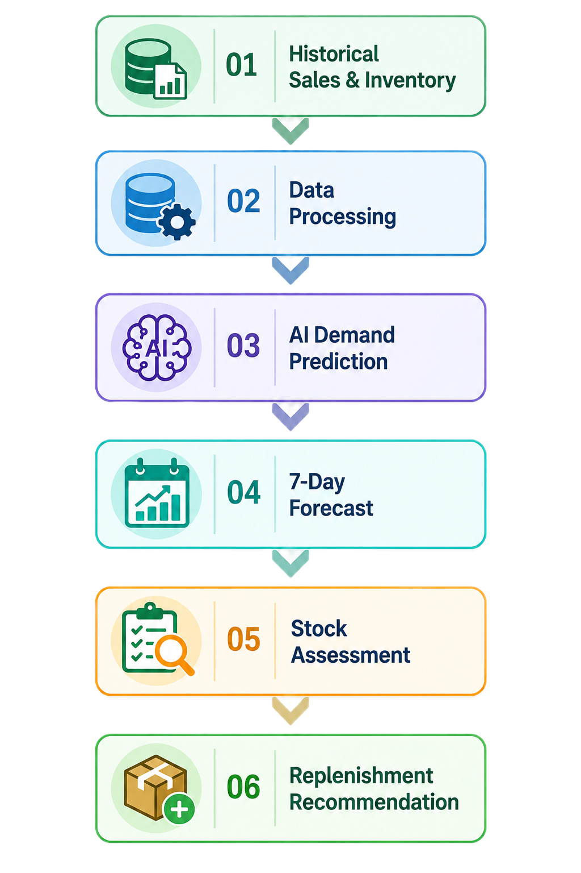
THE PROBLEM WE IDENTIFIED
OUR PROPOSED SOLUTION
Future medicine demand is uncertain, while inventory decisions are often made with limited predictive information
An AI-based decision-support system connecting demand prediction with stock assessment
CHANGING DEMAND
MANUAL ESTIMATION
INVENTORY DECISION
STOCKOUT RISK
OVERSTOCK RISK
Too little stock may fail to meet future demand.
Too much stock can create unnecessary inventory.
Decision support — the system does not automatically purchase medicines.

Slide 6
AI TECHNIQUES CONSIDERED
Linear Regression
Random Forest
LSTM Neural Network
Baseline prediction
Simple reference model
Nonlinear prediction
Handles multiple features
Sequential prediction
Learns demand sequences
Model Evaluation Metrics
Metric | What it Measures | Better Value
MAE | Average prediction error | ↓ Lower
RMSE | Prediction error, emphasizing larger errors | ↓ Lower
MAPE | Percentage prediction error | ↓ Lower

Slide 7
WHY RANDOM FOREST?
We compared approaches and selected the best practical balance
Model | Strength | Limitation | Decision
Linear Regression | Simple and fast | Too simple for complex patterns | Not selected
Random Forest | Robust; handles non-linear features | Larger model than linear | SELECTED
LSTM / Deep | Strong sequential modelling | More data, tuning and complexity | Not selected
300 DECISION TREES
NO SCALING REQUIRED
NON-LINEAR PATTERNS
FEATURE IMPORTANCE
Notes:
Member 2

Slide 8

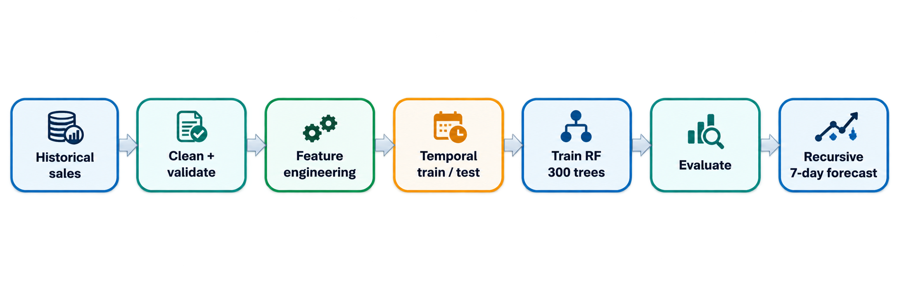
MACHINE-LEARNING PIPELINE
The model learns from the past and is tested on later dates
TRAINING PERIOD - Training data: up to 2025-12-31
TEST PERIOD - Testing begins: 2026-01-01
WHY TEMPORAL? - Avoid mixing future information into the past.
Notes:
Member 2

Slide 9
WHAT THE MODEL LEARNS FROM
CLOSED DAYS ARE NOT ZERO-SALES DAYS
Feature engineering converts raw sales history into useful signals
This business rule protects the meaning of the training data
OPEN DAY
Pharmacy operates
Sales are entered
Included in forecasting history
DAY OF WEEK - Monday vs. weekend effects
LAG 1 / 7 / 14 / 30 - Recent and recurring history
ROLLING MEAN - Recent average demand
ROLLING STD – Recent demand variability
DATE FEATURES – Month/calendar position
CLOSED DAY
Pharmacy does not operate
No sales row is created
Excluded from ML input
WHY IT MATTERS
A zero means “operated and sold nothing.”
Closed means “no observation.”
Notes:
Member 2

Slide 10
POSTGRESQL: OUR SOURCE OF TRUTH
All important operational data is centralized in one database
Medicines
Sales
Inventory
Medicine master data
Daily sales records
Current stock
Inventory
recommendations
Pharmacy
closed dates
Forecasts
Model predictions
Buy / Sufficient
Closed business dates
Notes:
Member 3

Slide 11
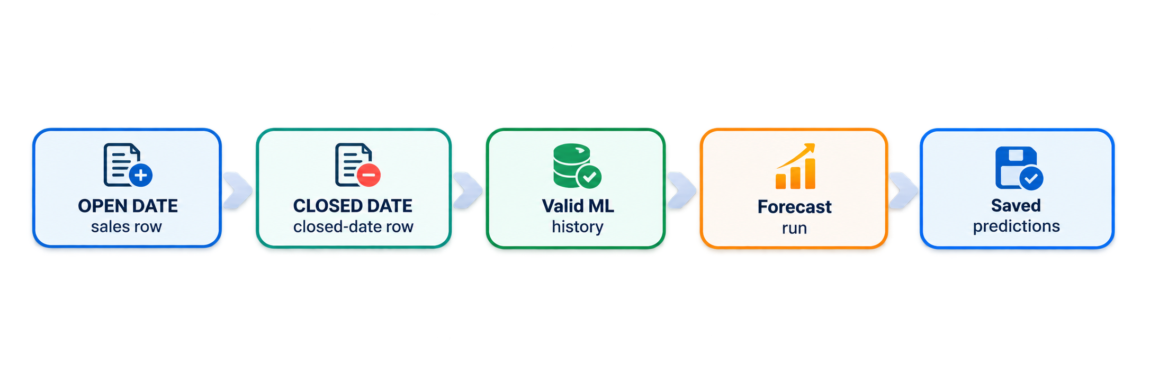
DATABASE LOGIC BEHIND FORECASTING
The database preserves the difference between an operating day and a closure
CLOSED DATE
FORECAST RUN DATE
No sales row is created. The date is stored in pharmacy_closed_dates and excluded from ML input
Each saved forecast records when it was generated, so different runs can be compared or retained
Notes:
Member 3

Slide 12
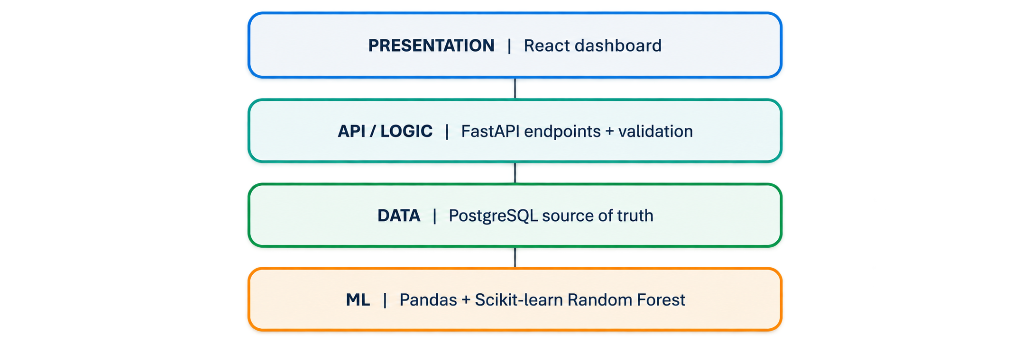
FASTAPI BACKEND: THE SYSTEM'S COORDINATOR
SYSTEM ARCHITECTURE
Four layers work together around PostgreSQL
Enter Sales - Validate + store daily sales
Mark Closed - Record closure; block sales
Run Forecast - Build features + predict
View Results - Return forecasts + recommendations
Update Stock - Persist inventory changes
Notes:
Member 3

Slide 13
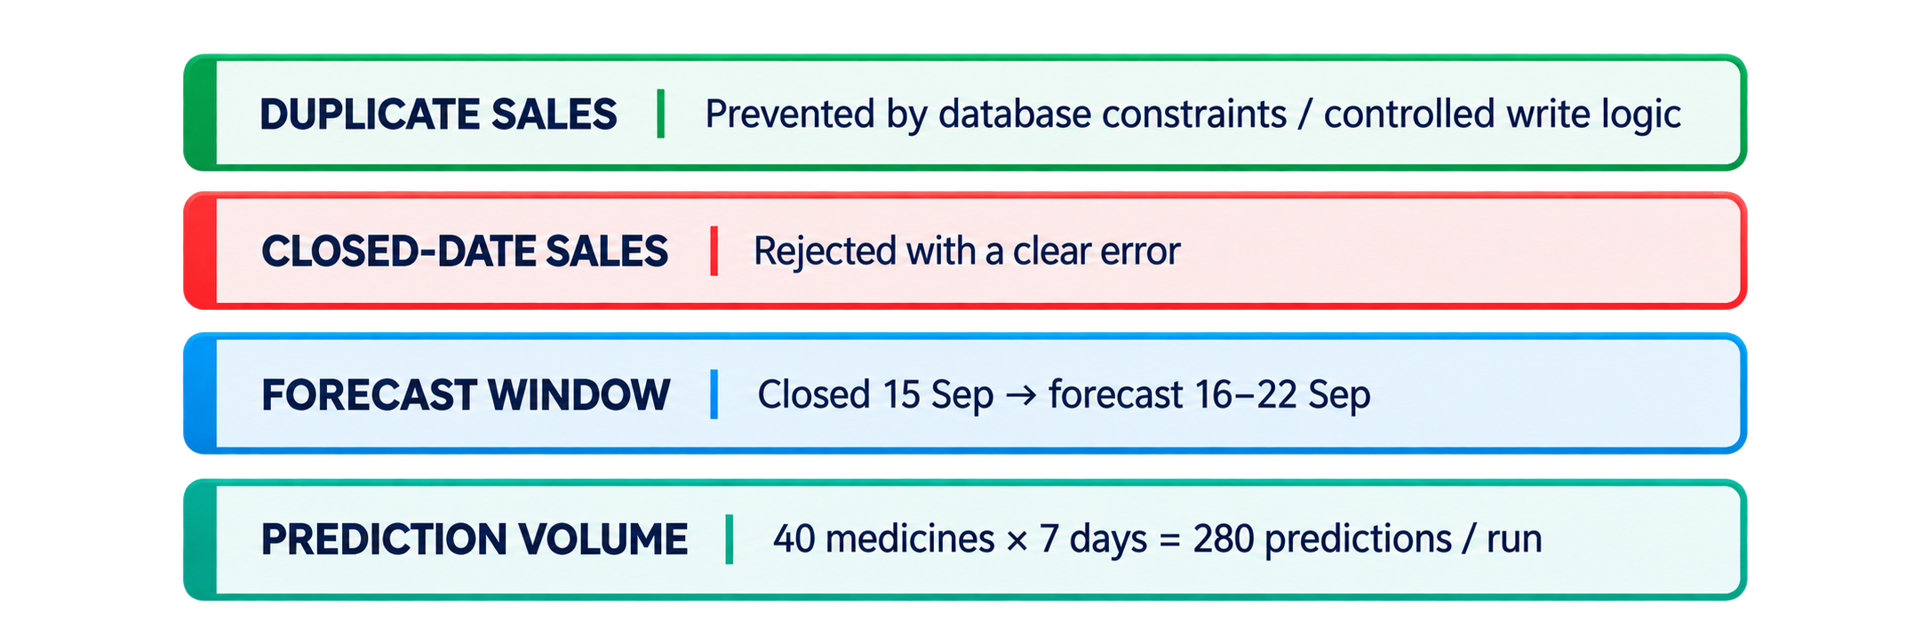
DEMO SCENARIO: CLOSED-DAY FORECASTING
VERIFICATION: WHAT WE TESTED
The system must behave correctly when the pharmacy is not operating
The final demonstration should show evidence, not only claims
EXPECTED RESULT
Forecast window:
16 Sep → 22 Sep 2026
The closed date itself is not forecast as a business day.
DATA INTEGRITY
No sales row for the closed date.
The model uses the last valid historical observations.
Notes:
Member 4

Slide 14
WHAT THE SYSTEM ACHIEVES
Decision support today, with clear paths for improvement
VALUE
LIMITATIONS
FUTURE WORK
• Forecast demand for 7 days
• Reduce stockout risk
• Reduce unnecessary over-ordering
• Give the owner a clear BUY / SUFFICIENT signal
• Forecast quality depends on historical data
• Model size is relatively large
• Real-world deployment and longer-term validation are still future work
• Deployment for real pharmacy use
• More historical data
• Holiday / seasonal features
• Notifications and stock alerts
• Further model experimentation
Notes:
Member 4

Slide 15


THANK YOU
Notes:
Member 4

